Slide 1



Efficient Large Scale Language Modeling with Mixtures of Experts
Author:Meta AI
Presented by:
Fadi Sultan and Msuega Jnr. Iorpenda

Slide 2

Main problem:
The computational inefficiency and high resource demands of scaling large language models (LLMs).

Slide 3
Large Language Models (LLMs)
are advanced neural networks designed to process and generate human-like text by learning patterns, context, and relationships within large-scale text datasets.
based on transformer architectures like GPT and BERT.
20XX | 20XX | 20XX | 20XX

Slide 4
SCALING
The process of increasing their size, capacity, and performance to achieve better results in natural language processing (NLP) tasks. This involves:
Increasing Model Parameters:
Adding more layers, neurons, or trainable parameters to capture complex relationships and patterns.
Example: Scaling from GPT-2 (1.5 billion parameters) to GPT-3 (175 billion parameters).
Expanding Training Data.
Leveraging Compute Resources: Utilizing powerful hardware (e.g., GPUs).

Slide 5
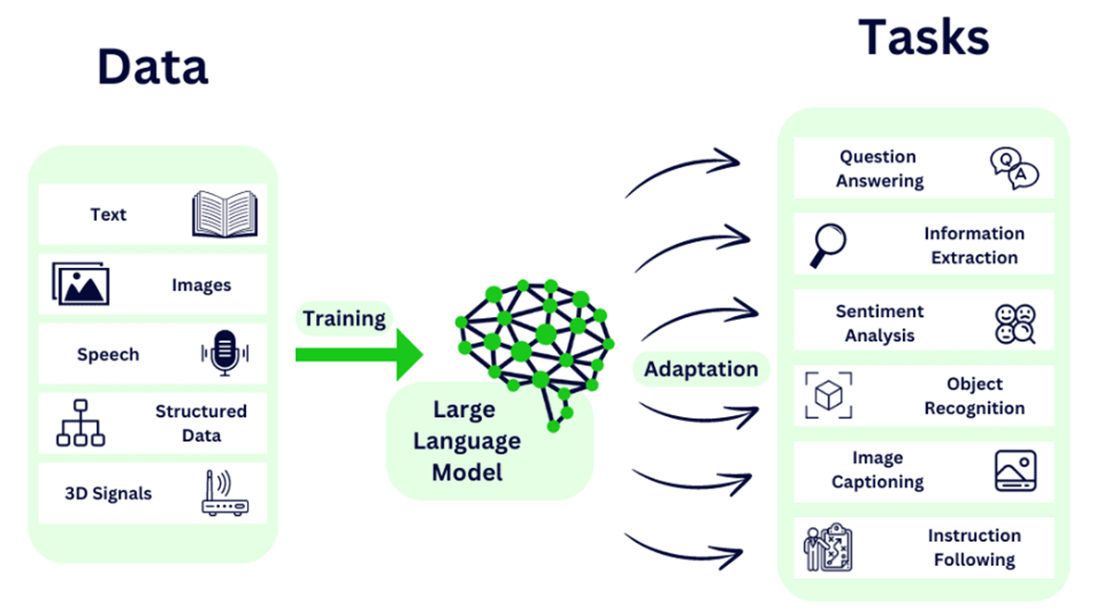
Large language models
Tasks:
Language translation.
Question answering.
Summarization.
and more.
France 30%
We 20%
the 15%
Are 10%
Were 10%
…..
Large Language Model
Paris is city in….
20XX | 20XX | 20XX | 20XX

Slide 6

The solution
Using Sparse model (Mixture of Experts (MoE)).
Instead of activating all parameters for every input, MoE selectively uses only a subset of its components, called experts, to process each input.

Slide 7
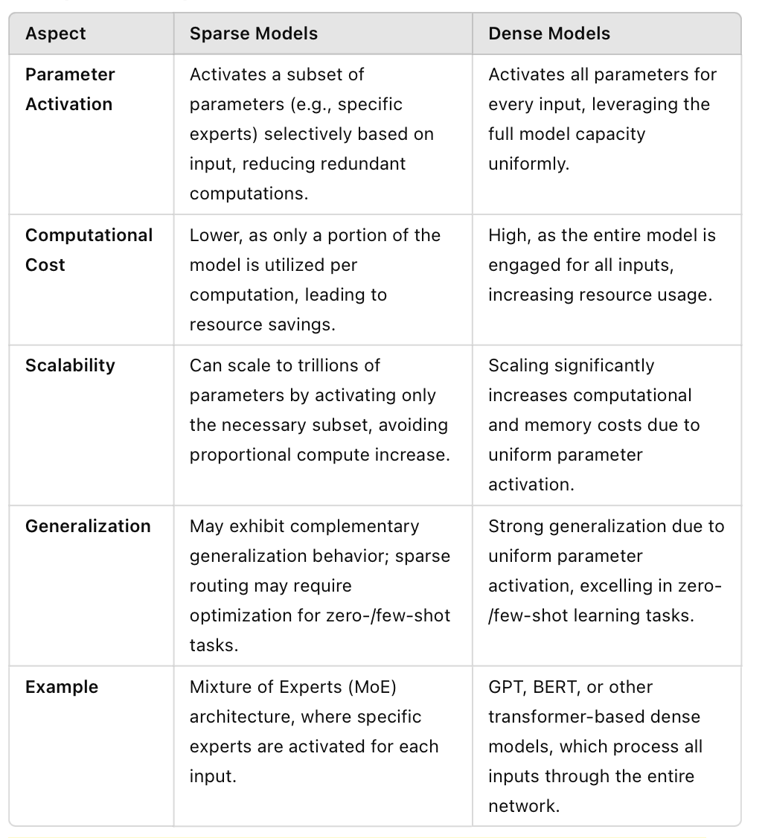
Show the audience you anticipated their questions.
Leave room for Q&A, but use the Appendix as a way to show that you both thought about those questions and have solid answers with supporting information. Let the audience test their understanding of the problem and the solution you’ve outlined - questions give them a chance to talk themselves into your approach, and give you a chance to show mastery of the subject.

Slide 8
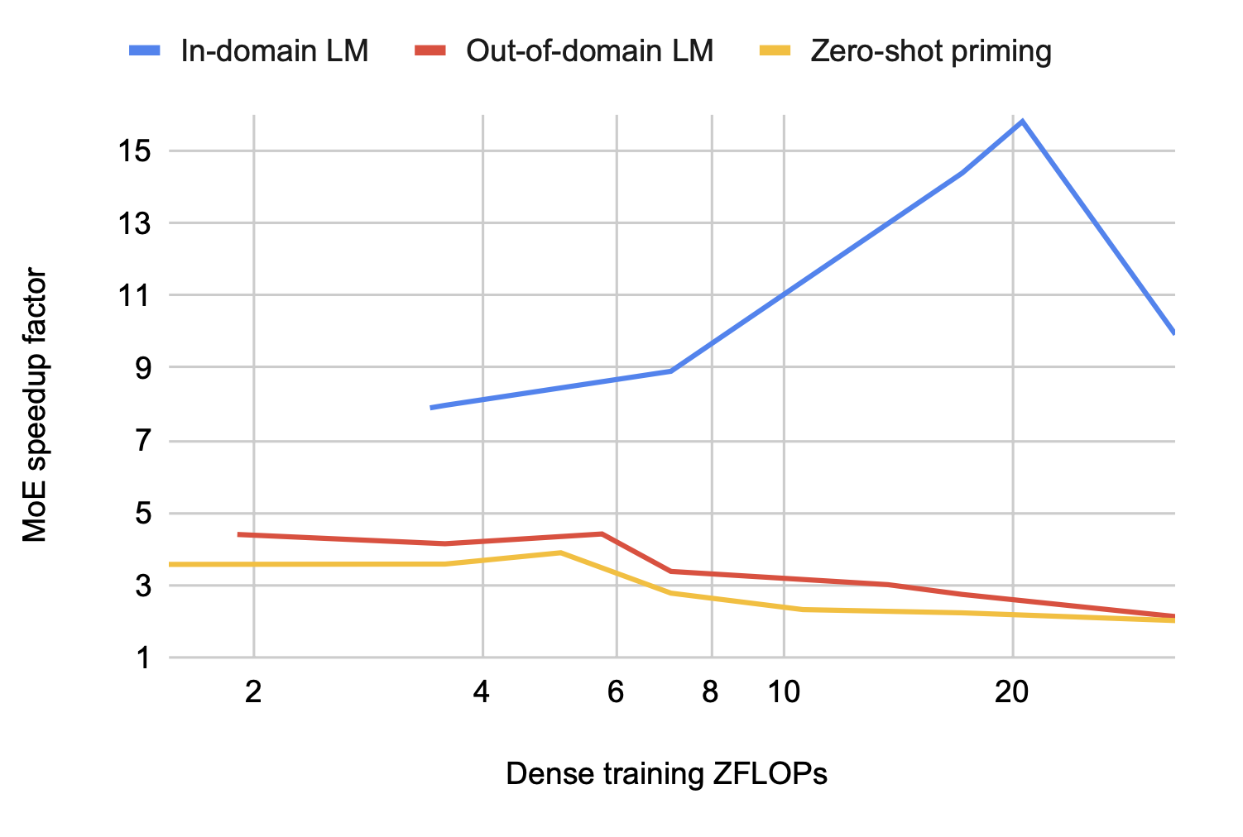
Show the audience you anticipated their questions.
Leave room for Q&A, but use the Appendix as a way to show that you both thought about those questions and have solid answers with supporting information. Let the audience test their understanding of the problem and the solution you’ve outlined - questions give them a chance to talk themselves into your approach, and give you a chance to show mastery of the subject.
zetta floating-point operations (ZFLOPs):is a measure of computational cost .
Zero shot:Tasks where the model is required to perform without any prior specific training or examples for that task.

Slide 9
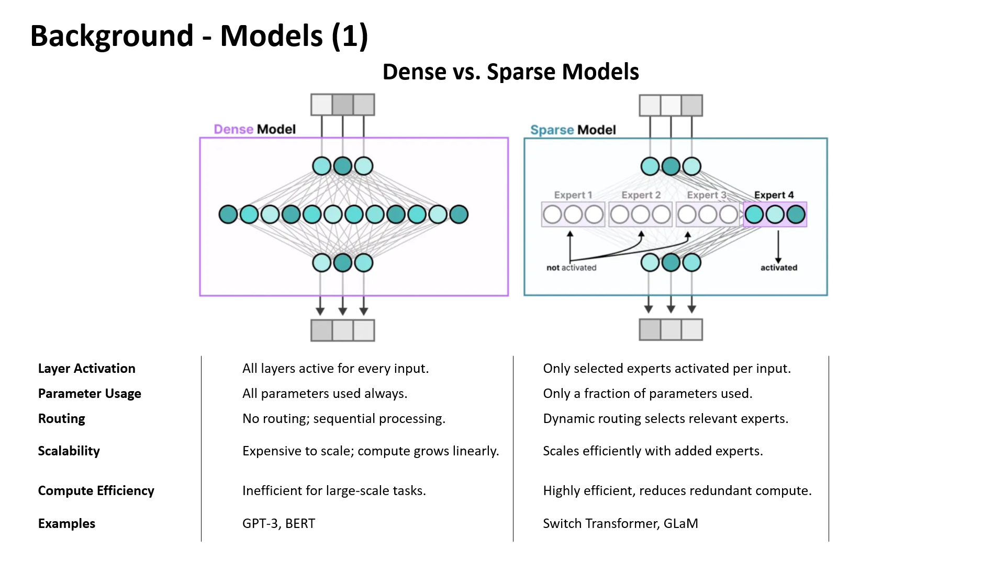

Slide 10
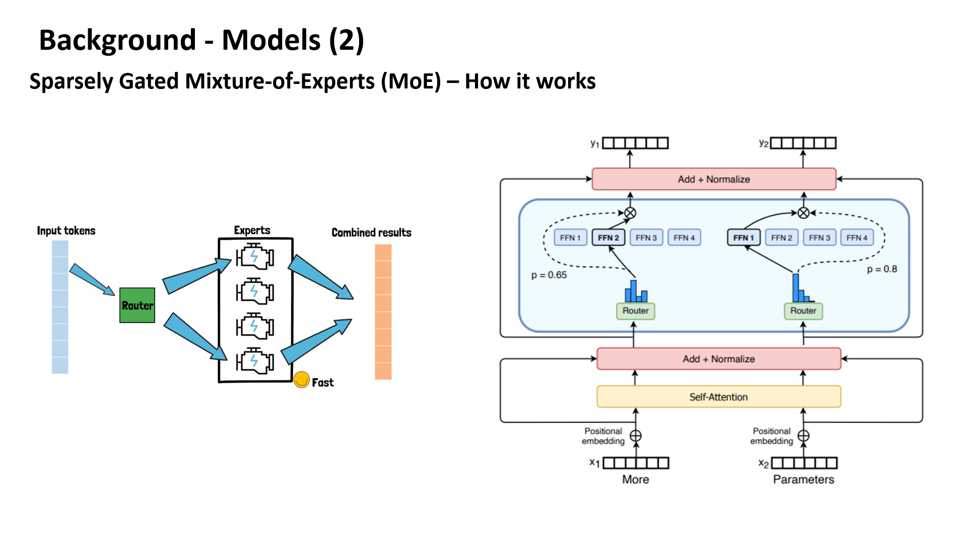

Slide 11
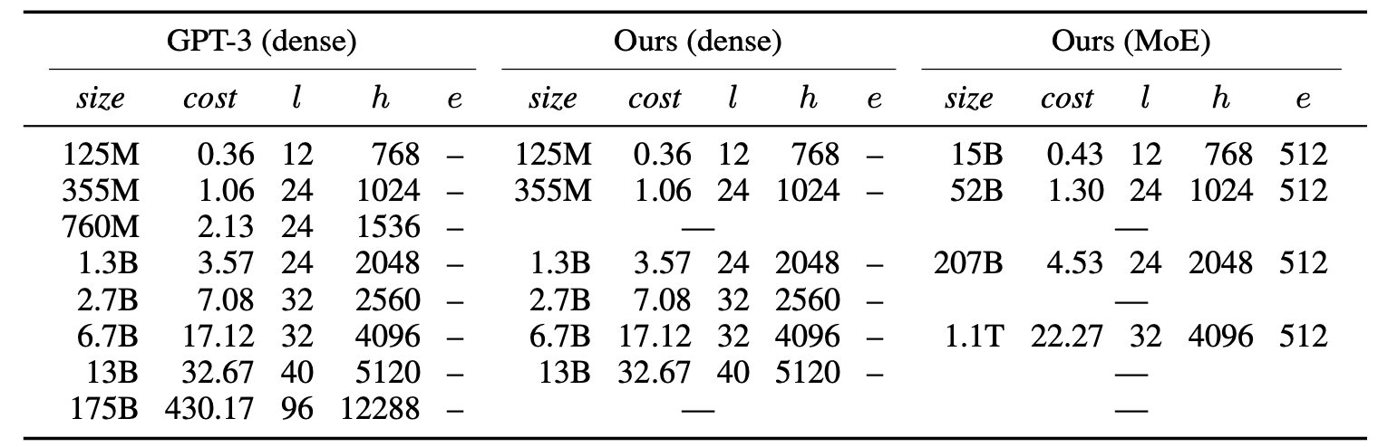
Models
Autoregressive (decoder-only) transformer models.

Slide 12
Pretraining data
The models pretrainon a union of six English- language datasets.
With totalling 112B tokens corresponding to 453GB and they are:
BookCorpus
English Wikipedia
OpenWebText
CC-Stories
English CC100
CC-News
The data had been trained using the same Byte-Pair Encoding (BPE) as GPT-2 and RoBERTa with a vocabulary of 50K subword units.
*RoBERTa improves BERT's training, excelling in NLP tasks like summarization.

Slide 13
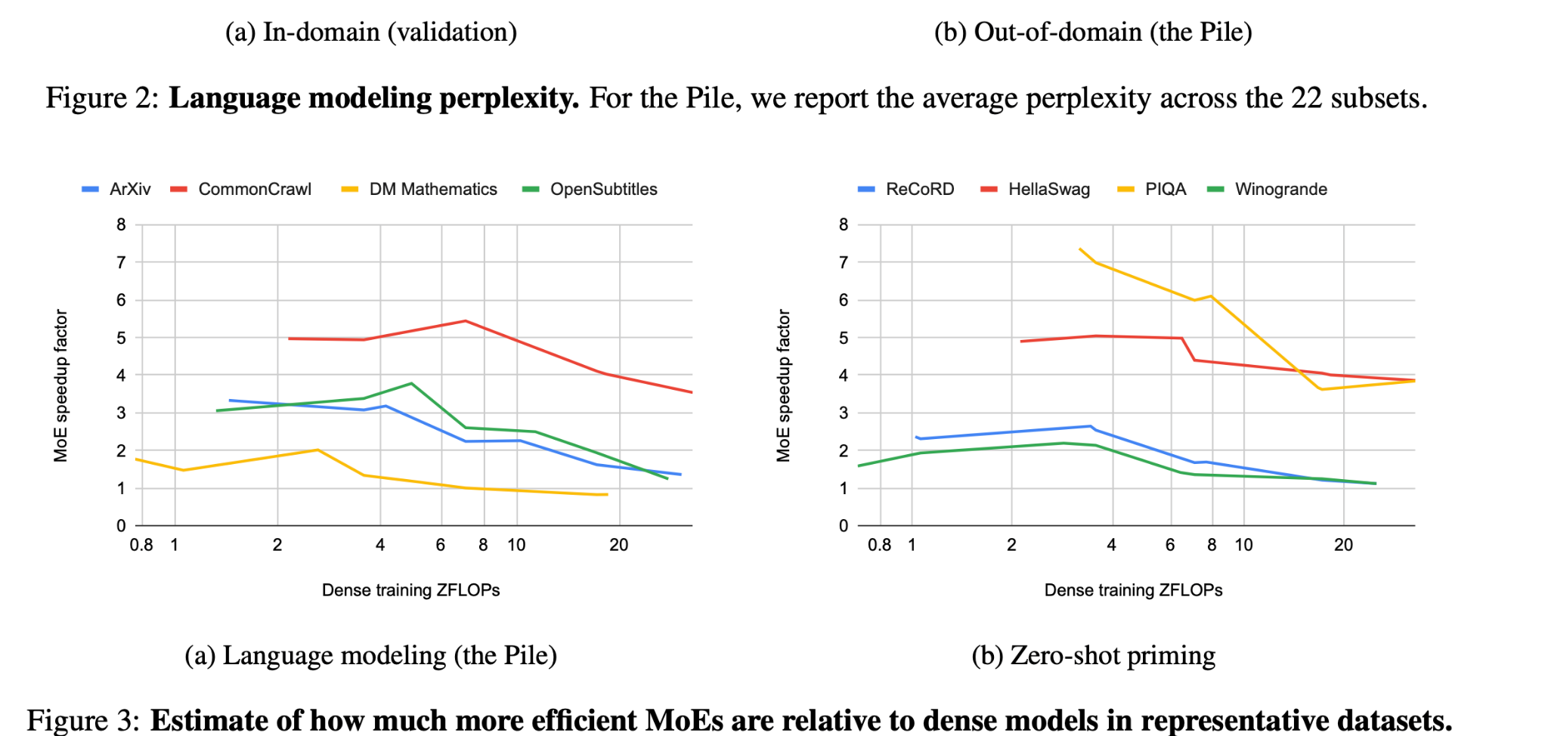
Evaluation

Slide 14
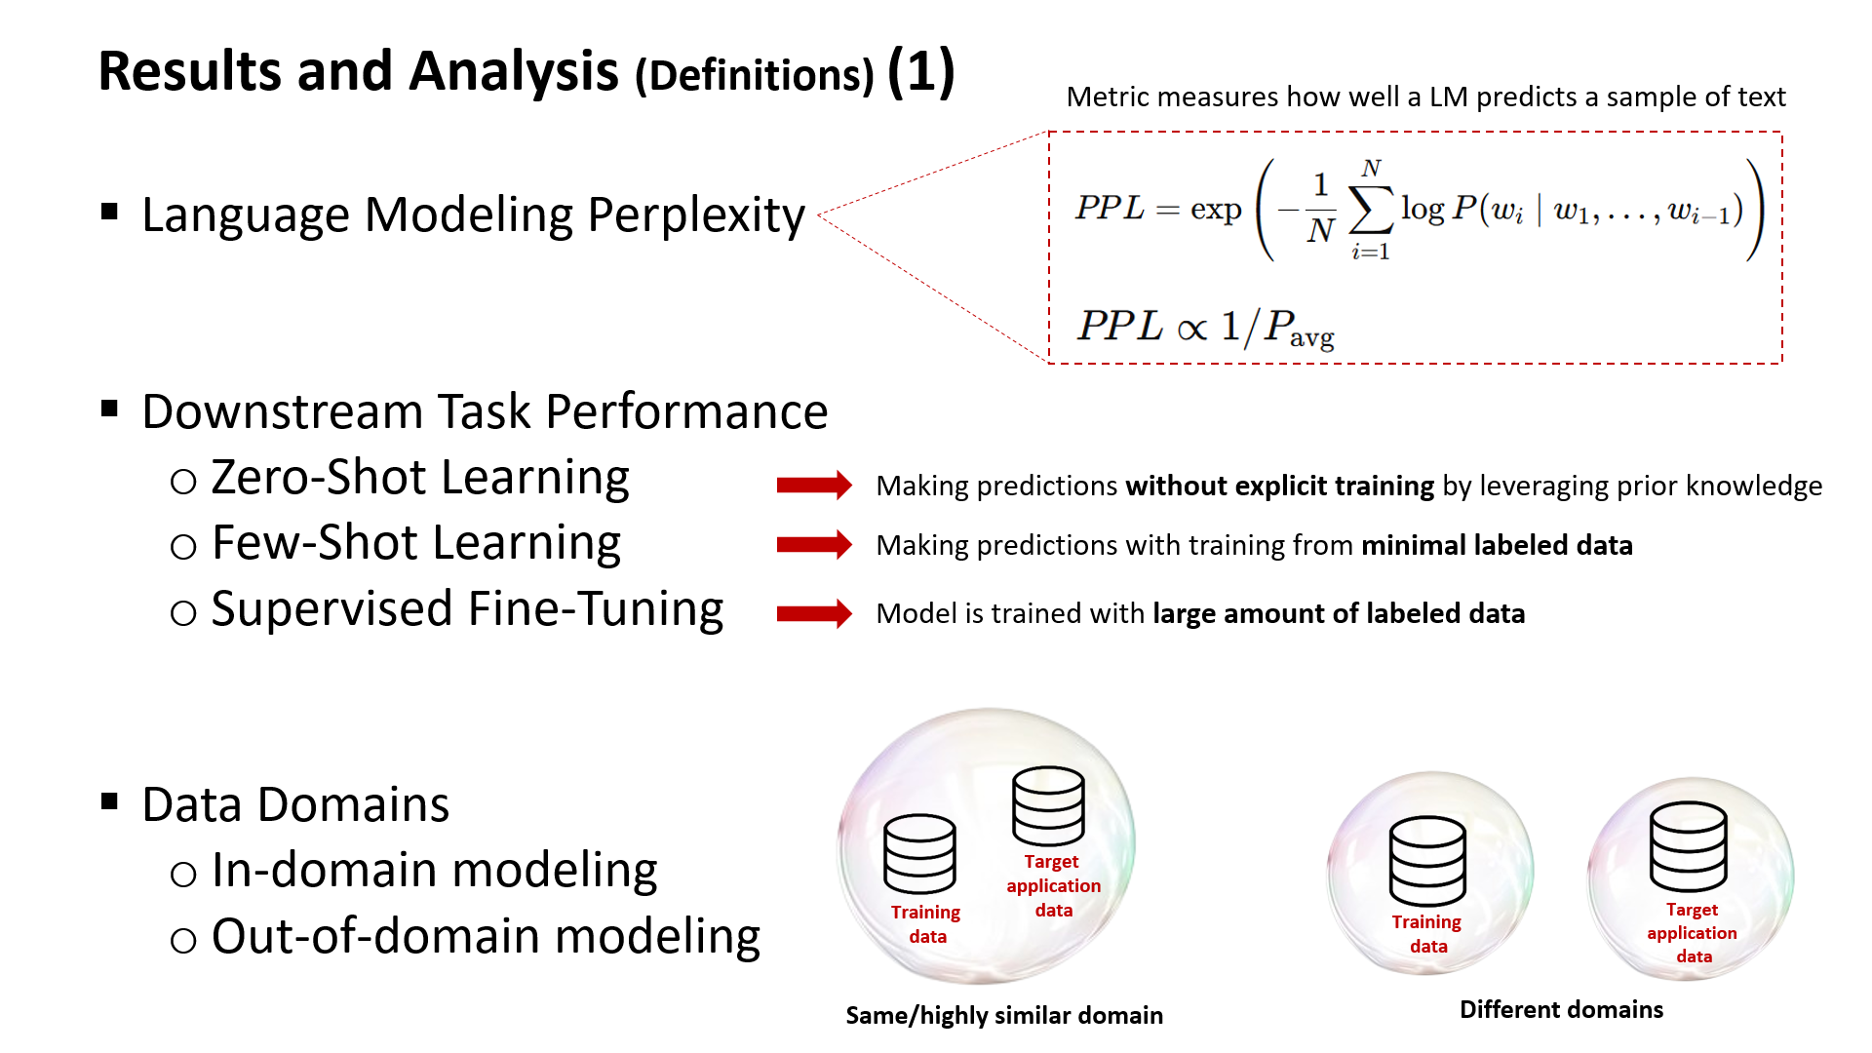

Slide 15
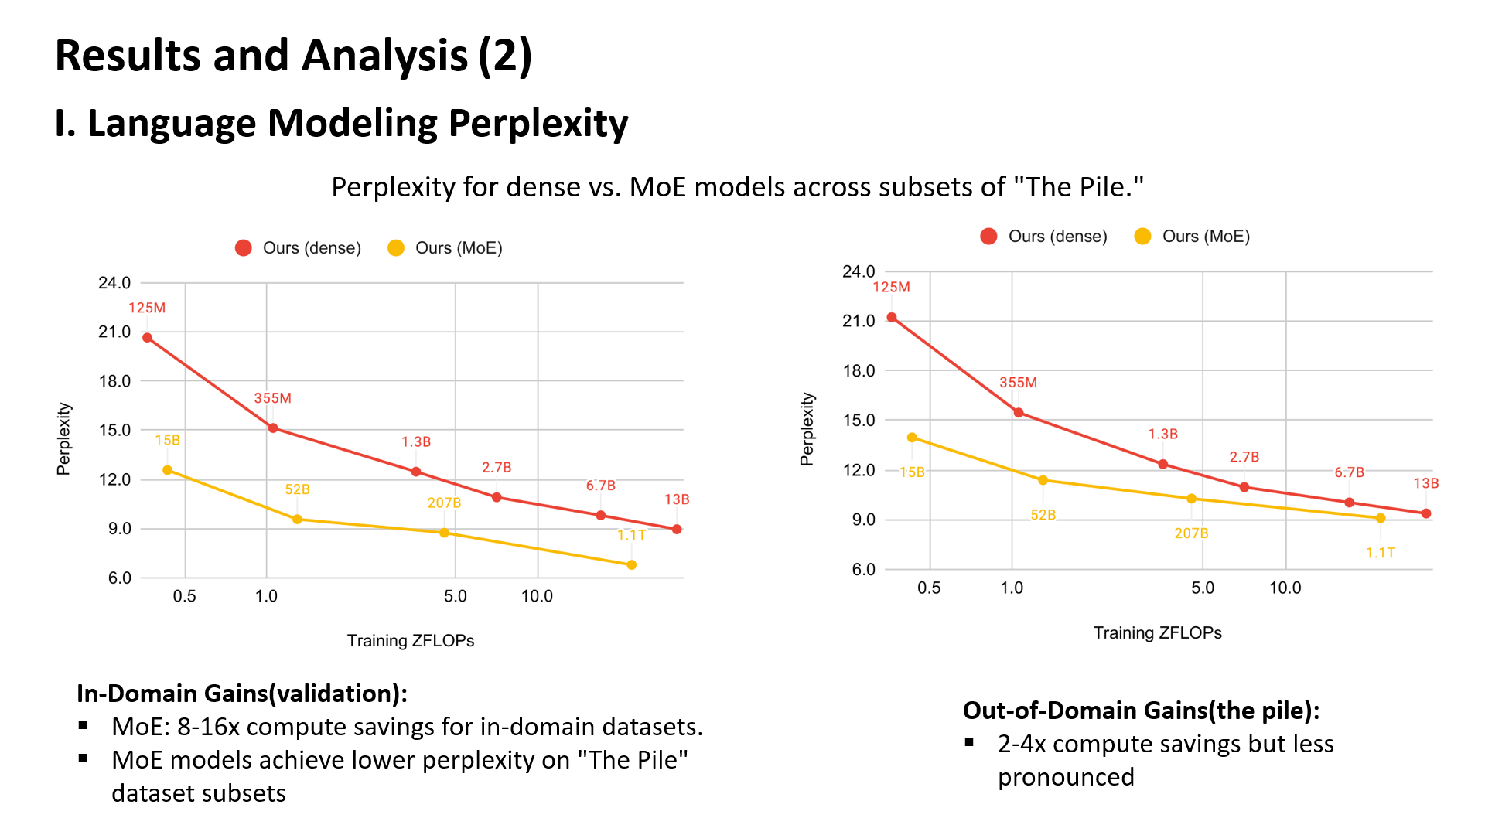

Slide 16
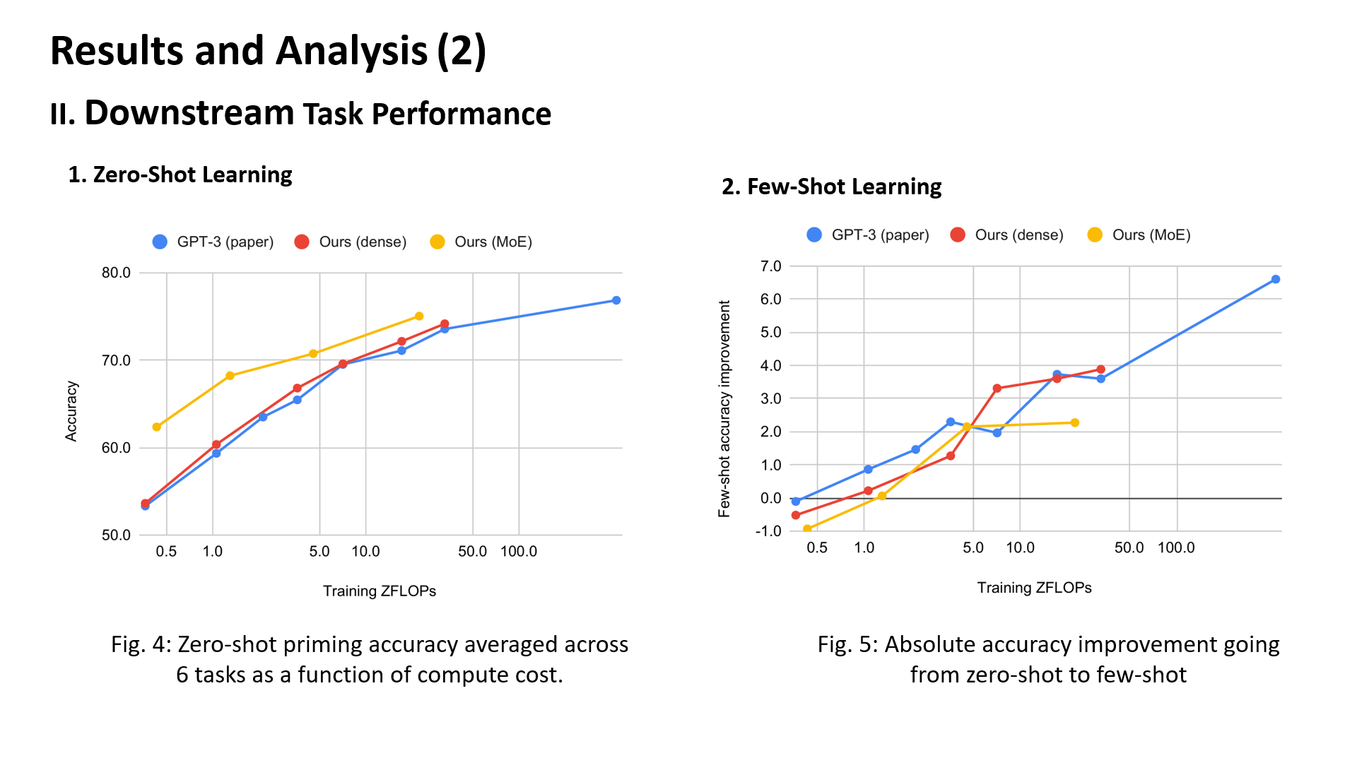

Slide 17
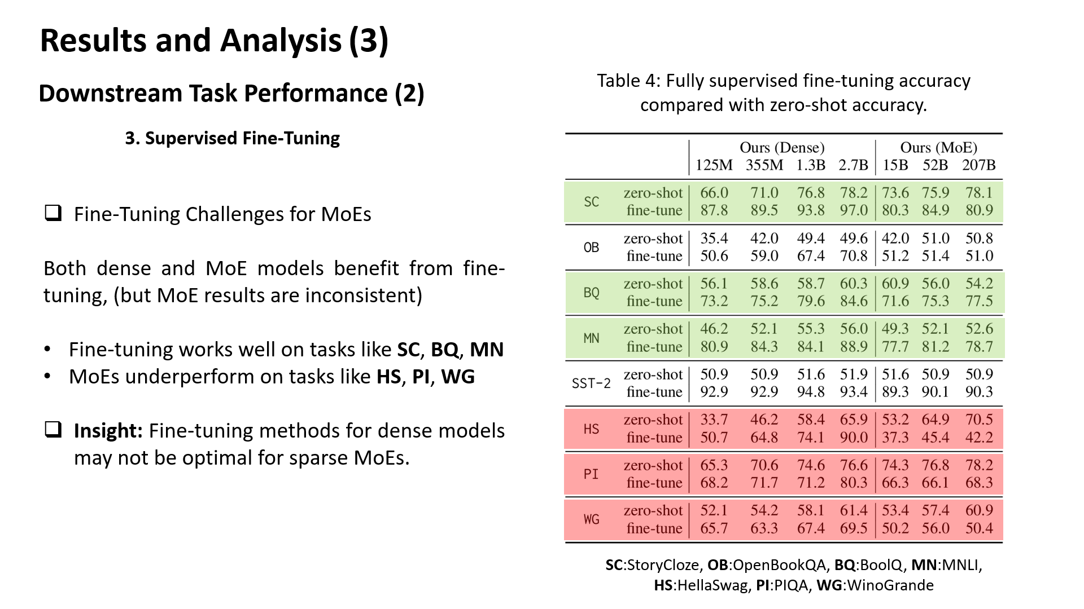

Slide 18
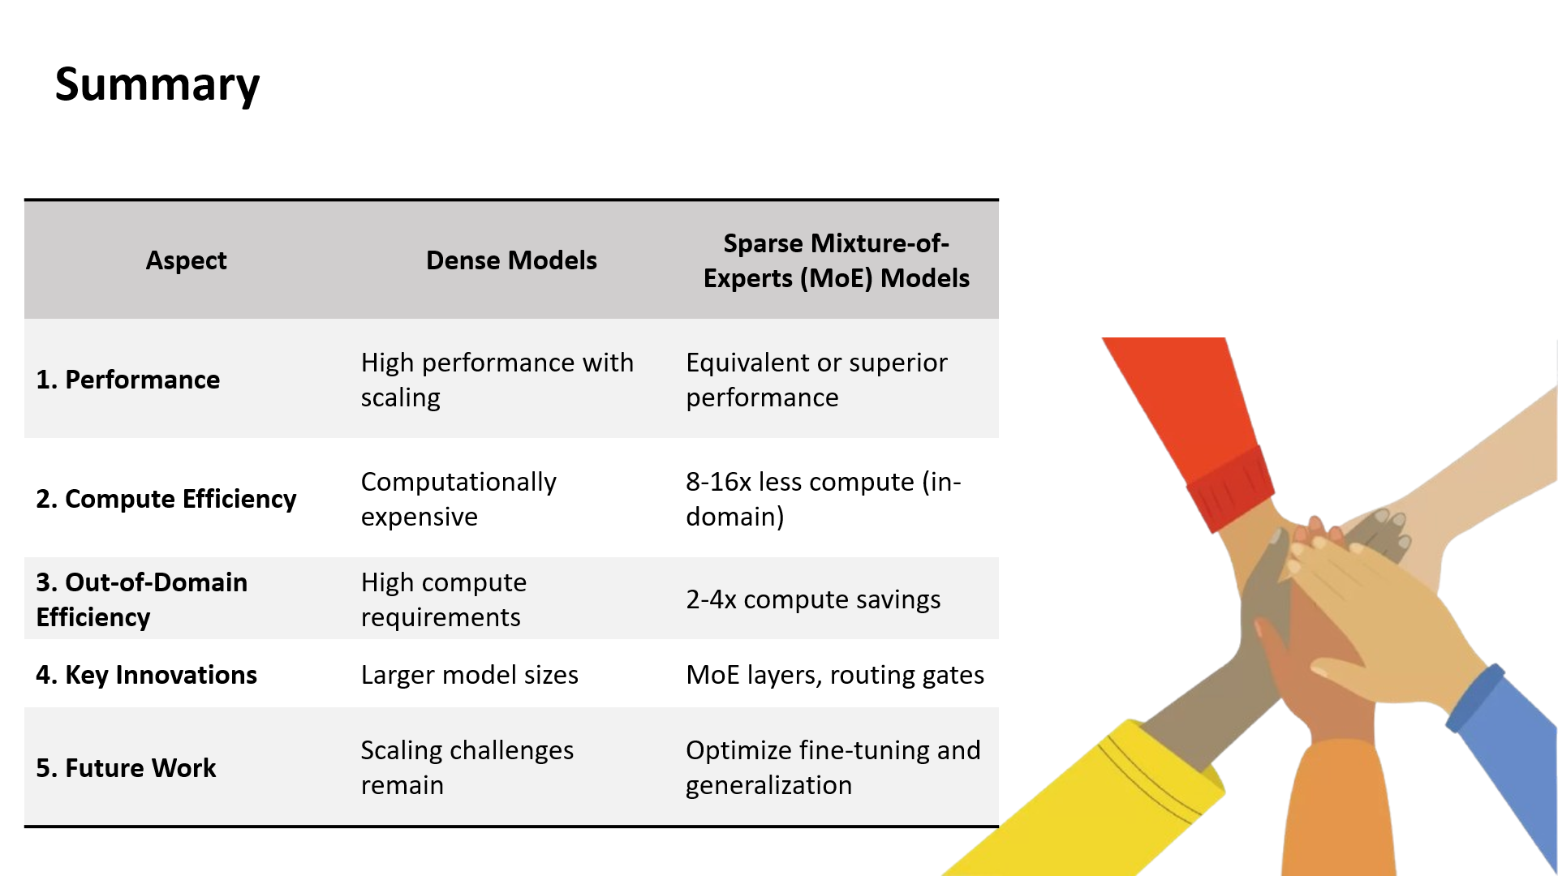

Slide 19

The technology:
GPS + RFID

